Slide 1
www.MINEPORTAL.in
ONLINE TEST SERIES FOR
GATE MINING
COAL/METAL FIRST/SECOND CLASS
COAL INDIA MT MINING EXAM
OVERMAN/SIRDAR EXAM
OTHER PSU MANAGEMENT TRAINEE EXAM
FREE STUDY MATERIAL/VIDEO LECTURES
ONLINE ORDER MINING BOOKS
CALL/WHATSAPP-8804777500 www.fb.com/mineportal.in

Slide 2

STUDY OF BLASTING IN OPEN CAST MINES

Slide 3
COURSE PROGRAMME
INTRODUCTION
EXPLOSIVES USED IN SURFACE MINES
BLASTING ACCESSORIES
SELECTION OF EXPLOSIVES
DESIGN OF BLAST PATTERN – INFLUENCING PARAMETERS
BLAST DESIGN IN SURFACE MINES – AN APPROACH

Slide 4
COURSE PROGRAMME
SECONDARY BLASTING
AREAS OF CONCERN IN BLASTING
MEASURES TO CONTROL ENVIRONMENTAL HAZARDS IN BLASTING
HANDLING OF MISFIRES IN BLASTING
WALL CONTROL TECHNIQUES
NEW DEVELOPMENTS / CASE STUDIES

Slide 5
1. INTRODUCTION
Current / Future Status of Surface Mining
Importance of Blasting in Opencast mines
Search for Better Blasting

Slide 6
Current / Future Status of Surface Mining
Surface mining practiced in Coal, Non-Coal mines – Copper, Iron ore, Zinc, Bauxite and Non-metallic sectors
Global Mineral Production
- More than 70% from Surface mines
- Less than 30% from Underground mines
Indian Mineral Production
- More than 80% of coal from surface mining
- Large volume of waste need to be removed

Slide 7
Importance of Blasting in Opencast mines
Objective of Blasting-Good Fragmentation
Fragmentation required simply to loosen the rock for easy excavation and transportation.
Efficient and Economic removal of Overburden and Ore/Coal.
Impacts of Environmental mandates and Safety requirements on Surface Mine Blasting Technology.

Slide 8
Search for Better Blasting
It has centered on safer, more powerful, less expensive blasting materials and techniques.
New explosives –Slurry, Emulsion from NG
Development of Bulk Loading Concepts
Development of Initiation systems – low energy detonating cords, SBM, NONEL, Electronic Detonators
Managing the Environmental threats!
Searching is an unremitting effort!!

Slide 9
2. EXPLOSIVES USED IN SURFACE MINES
What do mean by ‘Explosive’?
  Explosive is a substance, which under the influence of heat, shock or both, is capable of generating a large volume of gas at high temperature in an extremely short space of time on confined rock mass, thus breaking it.
Types of Explosives
  Low Explosives
  High Explosives
  For Explosive Initiation

Slide 10
Low Explosives
It burns and develop much low pressure
Gun powder/ black powder
It is a mechanical mixture of KNO3 (72-75%), charcoal (15-16%) and sulphur (10-12%)
20 KNO3+30 C+10S → (6K2CO3+K2SO4+3K2)+(14CO2+10CO+10N2)+600 cal/g
Speed is 450m/sec
Poor fragmentation with heaving effect
Used in manufacture of safety fuse; extraction of ornamental blocks; breakage of elasto-plastic materials

Slide 11
High Explosives
Characterized by very high rate of reaction and high detonation pressure.
  Nitroglycerin (1845)
  Dynamite (1860)
  Dynamite perfected and Non-NG, High AN, Cap Sensitive (1930 – 50)
  ANFO (1947)
  LOX (1930, in India)
  Slurry (1960-62)
  Cap-sensitive Slurry (1970)
  Emulsion (1978)
  Bulk Explosives (1980 -90)

Slide 12
NG Based Explosives
Compositions: NG-5%-90%; NC-Gelling/thickening agent & senstizer; Oxidizer-AN & SN; Fuel ingredients- Starches, wood flours, sulfur; NaCl-in permissible exp.
Sensitive to shock, friction & heat
High VOD of 7800m/sec ; temp@detn.- 3150 deg. C
Chemical reaction:
(NG) 4C3H5 (NO3)3 → 12CO2+10H2O+6N2+O2+1500 cal/g
Density:0.8-1.45, RBS: 73-79%, Temp.Res:-17 deg

Slide 13
NG Based Explosives
Advantages:
High strengths
High densities
High detonation velocity
Greater water resistance and chemical stability
Disadvantages:
Risk of accidents
Sensitive to friction and heat
Handling problems
High manufacturing cost
Examples: TELGEX-80/90/LD (TEL), OCG(ICI).

Slide 14
Ammonium Nitrate Fuel Oil
94.3% AN +5.7% FO (Oxygen Balanced)
Fuel Oil –Diesel Oil No.2 ( for 50 kg of AN-3.7 liters)
It is a cheap, low-density, cap-insensitive explosive, requiring primer charge of high explosives.
Sensitivity and Performance of AN, depends on ‘quality’ of the Prill supplied
Sensitivity or Energy increased by adding Fuel grade Aluminum and affected by water
Chemical Reaction:
94.3%AN+5.7%FO (Oxygen balanced) - 3NH4NO3+CH2 →3N2+7H2O+CO2+930 cal/g
Density: 0.8-0.9, RBS: 51-55%, Temp. Res:32 degC

Slide 15
ANFO
Advantages:
Superior in cost effectiveness
Safe to handle
Best suitable for dry holes
Explosive is prepared only at the site
No storage in magazine required
Disadvantages:
Desensitized in water
Inefficient in small dia holes
Unsuccessful blasting in hard rocks
Lower sensitivity
Not suitable for sleeping holes & hot holes
Examples: Deepak Fertilizers, Pune

Slide 16
Liquid Oxygen Explosive (LOX)
It is made by soaking cartridge of activated charcoal-27% (combustible ingredient) - in liquid oxygen (73%).
High detonation pressure (14*10000 atmos.) and explosion temperature (6600 degree C)
Large volume of gas is released at high temperature
Advantages:
Suitable for dense and medium rocks
No emission of noxious gases
It causes less vibrations than conventional explosive
Misfires can be handled safely after lapse of certain duration
Disadvantages:
Cost is high
Quicker evaporation ( life is shorter)
Unsafe
Example: LOXITE (IOL)

Slide 17
SLURRY
Addition of colloid such as ‘Guargum’ in ANFO, which builds up ‘Viscosity’, followed by Cross-linking agent which forms a gelled mixture.
Compositions:
Oxidizer: AN, SN; Fuel: Sugar, Coal, Amines, Paraffin; Thiourea & Guragum –Viscosity; Nitrostarch-Thickner; Cross linking agent-Potassium or Sod. Di-Chromates or Borax oxides; TNT, Al- Sensitizer
Plant or Truck mixed
Detonation velocity: 3000-4500 m/sec
Density:1.1-1.2, RBS: 53-65%
Temperature resistance: 4 deg.C

Slide 18
SLURRY
Advantages:
Water resistant
Effective utilization of explosives
Not subjected to friction or impact
It produces low non-toxic fumes
Disadvantages:
Life is only 6 months
Not suitable for high temperature conditions
Example: TELGEL (TEL)

Slide 19
EMULSION
Consists of oxiders dissolved in water surrounded by a fuel – fine particle size
Senstizer: air/gas bubbles or artificial glass micro balloons-hot spot; Emulsifier-waxes, gums
VOD: 4000-5000 m/s
Density range of 1.1 to 1.35 g/cc
High water resistant in full concentration
Plant of Truck mixed
High velocity and bulk strength
Temperature resistance: 4 deg. C
Example: Powergel (Orica)

Slide 20
Emulsion
Advantages:
High output of thermo-chemical energy
Cap sensitivity in low temperatures
Safety
Maximum Reaction factor of 0.97
Low cost
Low Post-detonation fumes
Disadvantages:
It causes problems when loading holes with fissures
Consistency in toe clearances
Sympathetic detonation

Slide 21
DEMERITS OF PACKAGED EXP
Manual charging
Cumbersome charging process (Slow rate)
Cycle time is more
No product flexibility
Partial energy utilisation due to decouping
Safety issues

Slide 22
BULK EXPLOSIVES
Explosives directly delivered into the blast hole through mechanised and mobile delivery system
Supplied to large opencast mines and civil construction projects
Useful, annual explosive consumption-2000 t
Types – Bulk ANFO, Bulk Watergel, Bulk Emulsion, HANFO

Slide 23
BULK ANFO
Prilled AN (94%) + Diesel oil (6%)
Initiation by DF or NONEL
Suitable for medium hard rock
Not suitable for wet holes
Very limited shelf life
Not suitable for variable climatic conditions
Economically cheaper than the rest

Slide 24
HEAVY ANFO
Loose Emulsion matrix physically with ANFO for creating voids to provide sensitivity
Mixture depends on required sensitivity, energy, water resistance and economics
Emulsion : ANFO – 70:30 or 30:70
Relative RBS and strength increases with emulsion content but sensitivity reduces.

Slide 25
HEAVY ANFO
Advantages:
Higher RBS of 130 compared to ANFO (expansion of drill pattern by 11%)
Cost of Drilling is reduced by 15%
Muckpile was low and well spread (suitable for Dragline benches – Cast blasting)

Slide 26
Benefits of Bulk Explosives
Safety
Inventory
Explosive vans
Manpower
Speed of operation
Explosive product
Blasting efficiency
Other features

Slide 27
Bulk Delivery Systems
Plant Mixed Explosive Delivery System
Mixed Slurry Pump Truck Delivery System
Gelmaster System
Blend Masters
ANFO and HANFO Delivery System
Repumpable Bulk Emulsion

Slide 28
Conditions for use of Bulk Explosives at Site
Making SMS, Charging and Firing under technical experts from manufacturer
Blasting crew shall observe the general precautions and relevant rules at site
Only minimum no. of persons to be present
No smoking, open flame, etc with in 3 m of site
No spillage of explosives while pumping
Proper record about charging and firing
Drilling should be completed before taking up charging
Area of charged hole marked by Red-flag /Red-light
Stemmed immediately after the charging, only short length of DF is exposed
Collar area of the hole should be covered with soft material as it does not come in contact with any discharge of static electricity or local strike of lightening energy.

Slide 29
U/G BULK EXPLOSIVES
Reasons for delay-introduction in U/g:
Harsh mining conditions in underground
Relatively smaller diameter drill holes
Advantages:
Speed
Product flexibility (density & energy)
Perimeter control
Post blast fumes minimized
Safety and security
No Magazine and minimum inventory
Improvement in pull (17%)
Improvement in Charge factor

Slide 30
EXPLOSIVE TYPES
Heavy Weight Cord (Cordtex 80 g/40 g)
- for perimeter holes
Decoupled Packaged Explosives (Powergel-801 – 25/32 mm – in 45 mm holes)
- for perimeter blastholes
Decoupled Bulk (Powerbulk Drive T)
- produces good results & low cost
Low Density Bulk (Powerbulk Drive)
- produces good results in hard ground and
lowest cost

Slide 31
POWERBULK DRIVE T (Orica)
Charging Unit
- Emulsion bin
- Pumping systems
- Minipump – 650 kg premix bin + charging rate of 15 kg/min + loading accuracy of 65 g
- Maxipump – 2.5 MT + 80 kg/min + accuracy of 125 g

Slide 32
Condition for Bulk Transport of Explosives
Trial shall be carried out under direct supervision of technical personnel of manufacturer for conversant of vehicle
No person allowed to ride upon, drive, load or unload the vehicle while smoking or under the influence of intoxicants
Caution shall be exercised while moving vehicle within the blasting area
Materials shall not be mixed while in transit
During loading, a positive grounding device shall be used to prevent accumulation of static charge
The hose shall be of semi-conductive discharge type.

Slide 33
3. BLASTING ACCESSORIES
Initiation / Firing Systems
  Non-Electric System
  Electric System
Exploders
Detonating Delay
Cord Relays

Slide 34
Non-Electric System
Safety fuse and Plain detonator
Plastic igniter cord (PIC) Combination
Detonating cord
Non-Electric Initiation System (NONEL)
  Shock Tube System
  LEDC
  Gas Initiated System

Slide 35
Safety fuse
Developed in 1831, is used to ignite low explosive and detonator to initiate high explosive.
It has a core of special black powder tightly wrapped with various layers of waterproof textile yarn/tape.
It burns at uniform rate of 100-130 sec/m
It has inaccurate timing, poor fragmentation, poor safety, and high incidence of cut off

Slide 36
Plastic igniter cord (PIC)
It is used to ignite several safety fuses in quick succession in any desired sequence.
It is 1.8-2.5 mm diameter, highly water resistant and capable of withstanding rough handling,.
It burns at uniform rate, either slow (33s/m) or fast (3.3s/m).
These can be ignited by flame or electrically by exploder.

Slide 37
Detonating cord (DF)
It gets initiated by a detonator and in turn propagates the shock wave to the explosive column.
It has a core of PETN (varying from 3 to 80 gm/m), wrapped in plastic tape/nylon cord layer, textile layer and finally a plastic covering to give strength of 50 to 60 kg.
VOD of 6500 to 7000m/s.
It is insensitive to shock and flame.

Slide 38
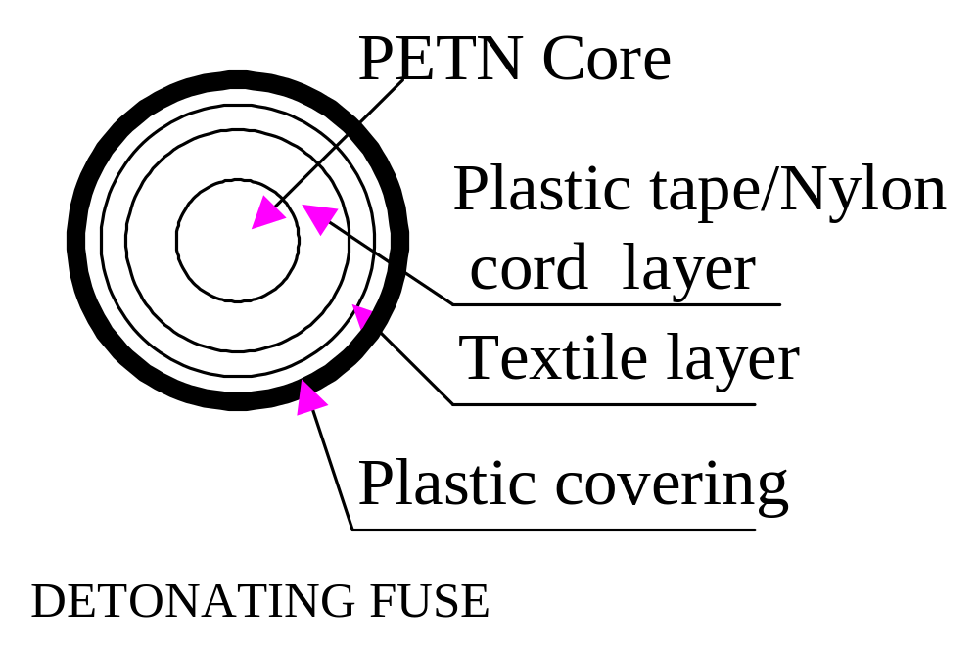

Slide 39
Shock Tube System
It is the down the line initiation system.
It comprising of high strength plastic/ polyfin polymer shock tube of 3-4mm outside diameter.
It is coated inside with a thin film of reactive explosive substance, HMX of 15-20mg/m.
There is a delay detonator attached at the end of tube. ‘Raydet’-developed by IDL, ‘Excel’-developed by ICI, ‘Amardet’- by Premier explosive Ltd.

Slide 40
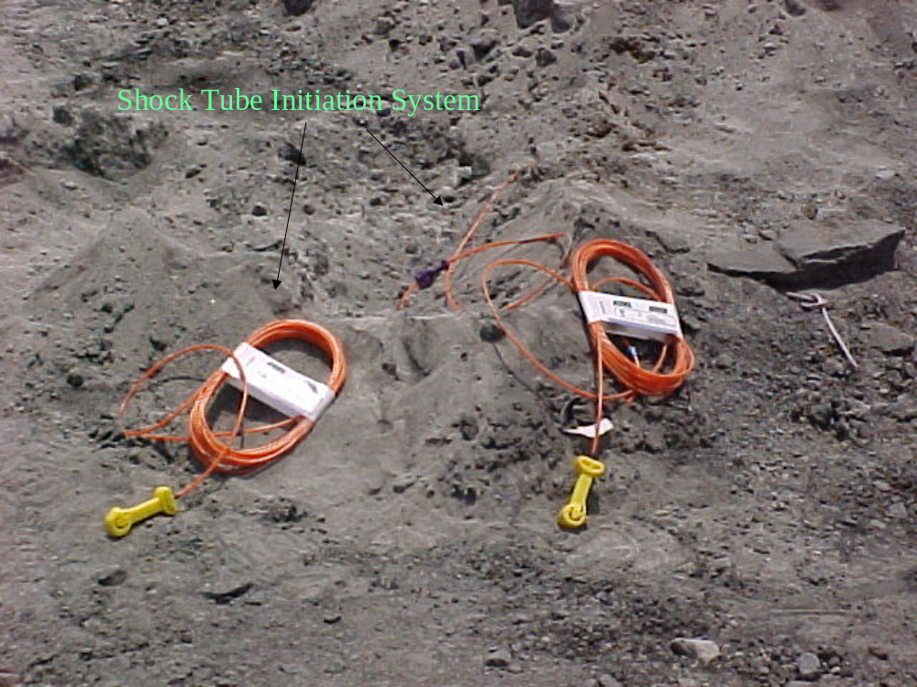

Slide 41
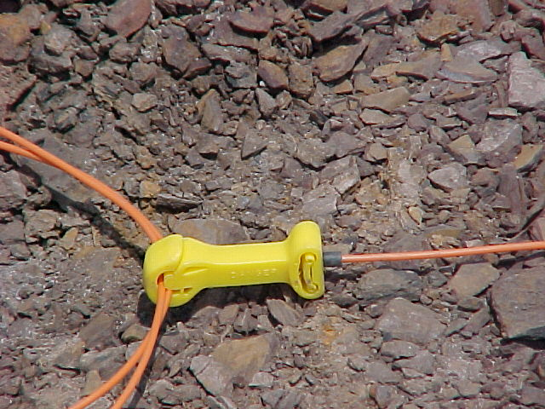

Slide 42
Advantages of Shock Tube System
True bottom initiation
Less air & ground vibration
Better high wall, roof and side stability
Not susceptible to stray electric currents, current leakage, radio frequency or static electricity, friction and impact
Better fragmentation.
Minimum pre mature venting through stemming.
Reduction in boulder generation
Improved toe- breakage
Reduced fly rock.
Improved cycle time
Improved (130%) tooth life

Slide 43
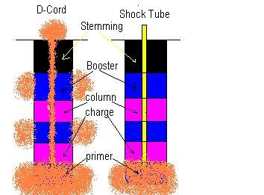

Slide 44
LEDC
Low energy detonating cord (LEDC) initiates a delay detonator crimped at one end.
Various cord lengths and delay periods are available.
‘Primadet’ of Ensign Bickford
‘Cordline’ of ICI

Slide 45
Gas Initiated System
Explosive mixture is used to fire detonators.
Two hollow plastic tubes are present in the place of lead wires.
No fuse head present in the shell
Detonators connected to one another in series thro’ plastic tubes and push fit connectors.
Two leads of blast hookup connected to a unit which mixes and pumps the explosive gas mixture through the hookup.
Spark delivered by ‘Fire’ Button, detonated the mixture which fires the detonators in the circuit.
‘Hercudet’ of M/s. Hercules Inc (USA)

Slide 46
Electric System
Ordinary / Plain Detonator
Electric Detonator
  Instantaneous
  Delay Detonator
    Long delay
    Short Delay
Sequential Blasting Machine
Electronic Detonator

Slide 47
Ordinary / Plain Detonator
Available in two categories, # 6(35mm long) & # 8(48mm long).
This has base charge of 0.22/0.48g of PETN and prime charge of 0.2g of ASA
ASA - lead Azide (A) + lead Styphnate (S) +
Aluminum powder (A)
Fired by safety fuses, the spark or ‘spit’ from the fuse causing the detonator to explode.

Slide 48
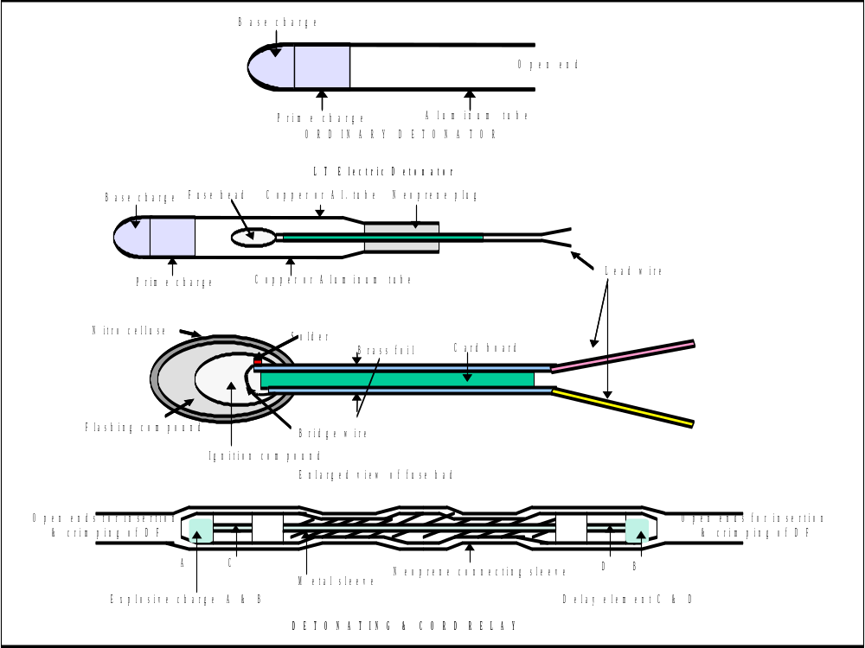

Slide 49
Electric Detonator - Instantaneous
Priming charge and base charge are the same as for Plain detonator.
Fired by passing electric current through fuse head.
The current ignites a flashing composition in the fused head, which in turn, initiates the priming charge.
Current required for ignition of fuse head is 0.5 amps so that a single detonator can be blasted with a min. voltage of 3.5v
Copper tube – U/g coal; Aluminum - Others

Slide 50
Electric Detonator - Delay
Basic features
Essentially low tension electric detonators with a delay element.
Delay element is by means of ‘Pyrotechnics’.
Pyrotechnics = use of ‘fire’ in actuation of a process, commonly, referred to as fireworks.
This delay element used to phase the firing of shots.
The statistical probability of two consecutive delay periods overlapping of 1% - 5% in timing is possible.

Slide 51
Electric Detonator - Delay
Basic Types
Long Delay Detonator (Half-second)
  Available in delay numbers of 0 -10 in Al. tube
  Delay interval is 300 ms
  For quarries, shaft sinking, drifting
Short Delay Detonator (Milli-second)
  Available in delay numbers of 0-10 with Al. tube
  Delay interval is 25 to 75 ms
  Used for surface mine blasting purposes, quarries

Slide 52
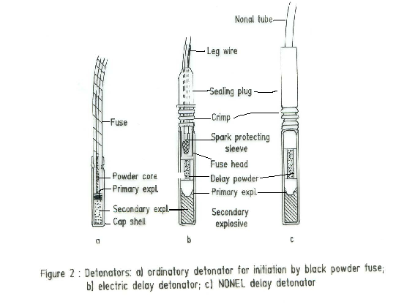

Slide 53
Benefits of Delay Detonators
Ground vibration control
Effective use of explosive energy for improved powder factor
Better fragmentation due to availability of free face after every delay
Control of noise, air-blast and fly rock due to less charge per delay
Improved machinery performance
Higher Productivity

Slide 54
Sequential Blasting Machine
It has been developed by research Energy of Ohio.
It is a solid state condenser discharge blasting machine that can initiate up to 10 individual blasting circuits in a sequence.
With programmable time intervals between circuit can be adjusted from 1 ms to 999 ms.
Accessories-Extension cable, Terminal board, Load plug, Corrosion resistant cable reel, Energy tester.
Used in large size blasts, to attain uniformity of interval of firing between rows and limit the charge per delay.

Slide 55
Electronic Detonator
Detonator
It utilize stored electrical energy inside the detonator as a means of providing the time delay and initiation energy.
It consists of an electronic delay unit in combination with an instantaneous detonator.
Microchip circuitry includes an oscillator for timing, memory, and communication functions
It has a capacitor, which can store sufficient energy to run the microchip and also to separate circuits.
The fuse head for initiating the primary charge with a minimum of time scatter.
Each detonator has its own time reference, but the final delay time is determined through interaction between the detonator and the blasting machine only immediately before initiation.

Slide 56
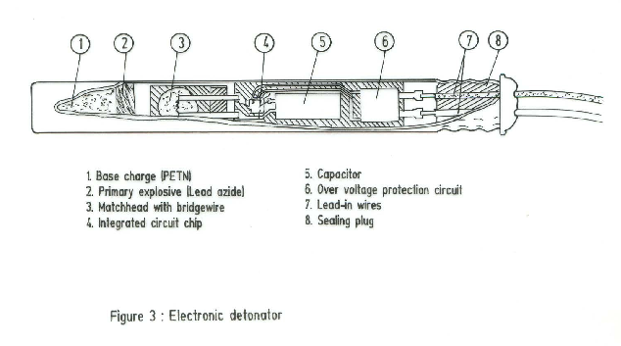

Slide 57
Electronic Detonator
Logger
It is used to communicate with the detonators during the hookup.
The required delay time for each detonator is entered and written into logger memory.
At any stage the logger can be used to check the hook-up and get the response from every detonator.
Blasting Machine
It communicates to each detonator in turn via the logger.
It is basically microcomputer controlled.
A panel with lamp indicates the current status and gives proceed signal when the round is ready to be fired.

Slide 58
Characteristics of Electronic Detonator
The detonator initially has no initiation energy of its own.
The detonators can be programmable from 1 to 8000 milliseconds in one-millisecond increments.
The detonator is equipped with over-voltage protection.
The short delay time between two adjacent period numbers (equal to the shortest interval time) is 1 ms.
The long delay time is 6.25 seconds.
The maximum number of detonators connected to each blasting machine is about 1600.
The electronic detonators scatter percentage varies around 0.01 percent for any programmed delay period.

Slide 59
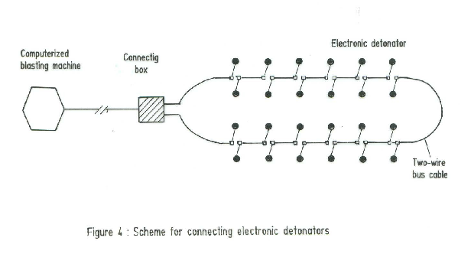

Slide 60
Advantages of Electronic Detonator
Inherent safety
Electronic detonators can be programmed to fire at any time from 0 ms to 8000 ms in steps of 1 ms.
A factory-programmed security code unique to the operator that will provide more security and prevent unauthorized use.
Interactive facilities with full two way communication ability.
Improved fragmentation.
It improves face advance and provide safe working environment.
Reduced stock management.

Slide 61
ACCESSORIES
CIRCUIT TESTER
In electric shotfiring, the circuit is tested to
ensure that there is no open or short circuit
and such tests are being done by ‘Blastometer’.
CRIMPER
It is a pair of pliers to crimp or press the end of
a plain detonator tube on a safety fuse inserted
into it.

Slide 62
ACCESSORIES
EXPLODER
Machines which give us the required electrical power to fire a series of detonators or single detonator.
Two types: Generator (Magneto) & Generator discharge type
Capacity of Exploder – 1.5 to 2 times the needed capacity (to be fired detonators).
Dry batteries should not be used.
Use low voltage Exploder in case of conducting ore bodies due to ‘arching effect’.

Slide 63
ACCESSORIES
Shot firing cables
  To fire the shots from the long distance
Wooden stemming rod
  To stem the holes
Scraper
  To clean the holes and detect cracks
Pricker
  To prick the cartridge prior to inserting the detonator or detonating fuse and it is made of brass, aluminum or wood.

Slide 64
SELECTION OF EXPLOSIVES
Overall Objectives
The lowest cost per unit volume of rock broken
The desired degree of fragmentation and muckpile looseness and profile
Avoidance of undesirable environmental effects, such as vibrations, air blast and fly-rock.

Slide 65
SELECTION OF EXPLOSIVES

Slide 66
SELECTION OF EXPLOSIVES
Physical Selection Parameters
Detonation Performance Selection Parameters
Site Specific Selection Parameters
Safety and Overall Economics

Slide 67
Physical Selection Parameters
Density
  Weight of explosives per unit of volume
  Expressed in grams per cubic centimeter (g/cc)
  Loading density – kg of explosive per meter
Sensitivity
  Measure of the ease of initiation of explosive or minimum booster size required
  Vary according to explosive composition, diameter, temperature, ambient pressure

Slide 68
3. Water resistance
  Ability of explosive to withstand exposure to water without losing sensitivity or efficiency
4. Chemical Stability
  Ability to remain chemically unchanged and retain sensitivity when stored under specified conditions
  Factors that effect chemical instability
    Heat, cold, humidity, quality of raw materials, contamination, packaging and storage facilities
5. Fume characteristics
  At the time of detonation, explosive produce non toxic and toxic fumes

Slide 69
Detonation Performance Selection Parameters
Absolute weight strength (AWS)
  Maximum theoretical explosive heat energy based on the ingredients in the explosive
  Energy per unit of weight expressed in kilo-calories per gram
Relative weight strength (RWS)
  It is an explosive’s weight strength compared to ANFO
Absolute bulk strength (RBS)
  Energy per unit of volume, in cal/cc
  Equal to the explosive’s AWS multiplied by its density

Slide 70
4. Relative bulk strength (RBS)
  It is an explosive’s (actual) bulk strength compared to ANFO
5. Detonation velocity (VOD)
  Rate at which detonation wave travels through the explosive, m/sec
  Varies with charge diameter, explosive density, explosive particle size and degree of confinement for non-ideal explosives
  It is the main component of shock energy and responsible for rock breakage
  It should meet or exceed the sonic velocity of the rockmass (impedance matching)
  It can be measured to determine the explosive efficiency
6. Detonation Pressure
  Pressure produced in reaction zone of explosive, Mpa
  It is obtained by multiplying explosive density with its square of VOD (km/sec), and 250

Slide 71
7. Borehole pressure
  Pressure on the walls of the blasthole from the expansion of detonation gases
  The volume and rate that gas is produced by the explosive controls the heave or displacement of the rockmass
8. Explosive energy/power
  The rate of doing work or amount of useful energy liberated in the detonation process
  ‘Bubble energy’ and ‘Brisance energy’
  It depends on both AWS and detonation velocity
9. Effective energy
  The total energy released by an explosive until the gases vent

Slide 72
Site Specific Selection Parameters
Cost of drilling / availability
Rock type
Blasthole diameter
Ambient temperature
Water
Explosive cost
Safety and Overall Economics
Safety characteristics are the property to enable transportation and use of explosive under normal forms.
Aggregated drilling and blasting costs

Slide 73
CLASSIFICATION OF EXPLOSIVES
Class 1: Gun powder
Class 2: Nitrate Mixture
Class 3: Nitro compunds
Div I: BG, SG, etc
Div II: Guncotton, PETN, TNT, etc
Class 4: Chlorate mixture
Class 5: Fulminate
Class 6: Div I- Safety fuse, Ignitor cord
Div II- DF, Plastic ignitor cord
Class 7: Fire works
Class 8: LOX
Category X: fire/slight risk of explosion
Category Y: mass fire or moderate explosion risk but not the risk of mass explosion
Category Z: mass explosion risk and major missile effect
Category ZZ: mass explosion risk and minor missile effect

Slide 74
STORAGE, HANDLING AND TRANSPORTATION OF EXPLSOIVES
Magazine
All explosives meant for use in mines stored
License issued by C.C.O.E, Nagpur
Essential requirements:
Separate chamber for detonators
Different racks for storing different classes of explosives
Windows and doors made up of steel plate
Steel fittings connected to an efficient earth system
A good earthing system should be provided

Slide 75
‘Z’ type staggered ventilators should be provided
Barbed wire fencings or a brick wall not less than 1 m high wall shall be provided around the magazine, 8-10 m from building
Buildings must be constructed on a site away from high tension power lines, public roads, dwelling houses, railways, etc.
Shed may be constructed over the building to cutoff heat during summer.
Provision shall also be made to keep the area dry and clean.

Slide 76
PORATABLE MAGAZINE
The walls should be made of 1/4” mild steel plates
Inside wall, floor and ceilings should be lined with wood planks
Ventilators are provided for free circulation of air
The whole structure is anchored to basement of brick work.

Slide 77
RESERVE STATION
Cases or containers of explosives shall be kept underground only in reserve station.
It shall be kept clear, dry, white washed and secure.
All places within 18 m of the station shall be kept clear and secure.
The floor of the surrounding places shall be covered heavily with stone dust.
No energised cable is allowed to pass within the distance of 90 m from station

Slide 78
TRANSPORTATION
As per Reg.157(4)/MMR & 163(4)
Bulk transport of explosives
10 t / half carrying cap of wagons
Not more than 90 min before charging
Jeep for detonators ( not more than 200)
2 fire extinguishers
Speed of 25 kmph
Explosives and detonators not together

Slide 79
DESIGN OF BLAST PATTERN – INFLUENCING PARAMETERS

Slide 80
Fragmentation
Economics of Blasting
Explosive Parameters
Rock Parameters
Charge Loading Parameters
Blast-Geometry Parameters

